Slide 1


Ink Canvas
Submitted By:
Japneet Kaur
2210990433
Group 10
Submitted to:
Mr. Tushar Khitoliya
Dr. Shagun Sharma

Slide 2


Table of Contents
Problem Statement
Introduction
Objectives
Technical Details
Key Features
Dashboard Snapshots
References

Slide 3

Problem Statement
Lack of Versatility: Traditional White Boards are not Versatile enough for modern collaborative environments.
Limited Functionality: Basic drawing and writing capabilities, lacking multimedia integration and real-time collaboration features.
Digital Transformation Hurdles: Users transitioning from physical to digital whiteboards need intuitive and user-friendly solutions.

Slide 4

Introduction
User-friendly Interface: Ink Canvas provides an intuitive and easy-to-navigate interface for users.
Interactive Elements: Introduction of interactive elements like buttons, menus, and entry widgets.
Empowering Creativity: Ink Canvas empowers users to express ideas creatively and collaborate effectively.

Slide 5


Objectives
User-Friendly Interface: Design an intuitive and visually appealing interface for Ink Canvas application, ensuring ease of use for all skill levels.
Customization Options: Provide users with tools to personalize their canvas with different drawing tools, colors, backgrounds, and preferences.

Slide 6

Technical Details
Python: Backend scripting language for functionality.
Tkinter Library: Widely used for GUI development in Python.

Slide 7
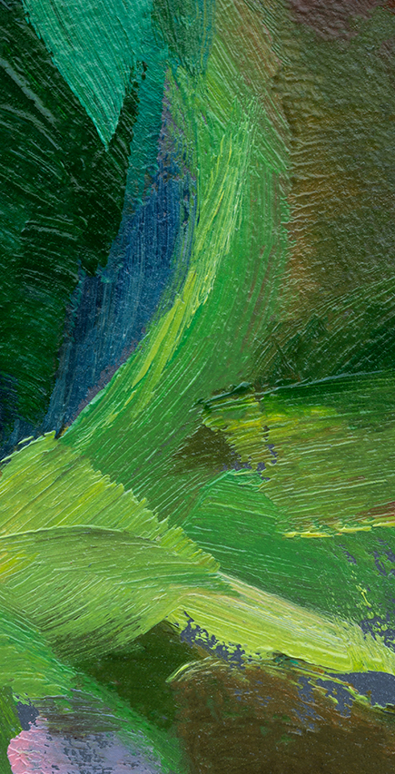
Key Features
Flexible Canvas: The canvas provides a blank space for drawing, erasing, and modifying elements.
Customization Options: Users can customize the pen color, and thickness.

Slide 8
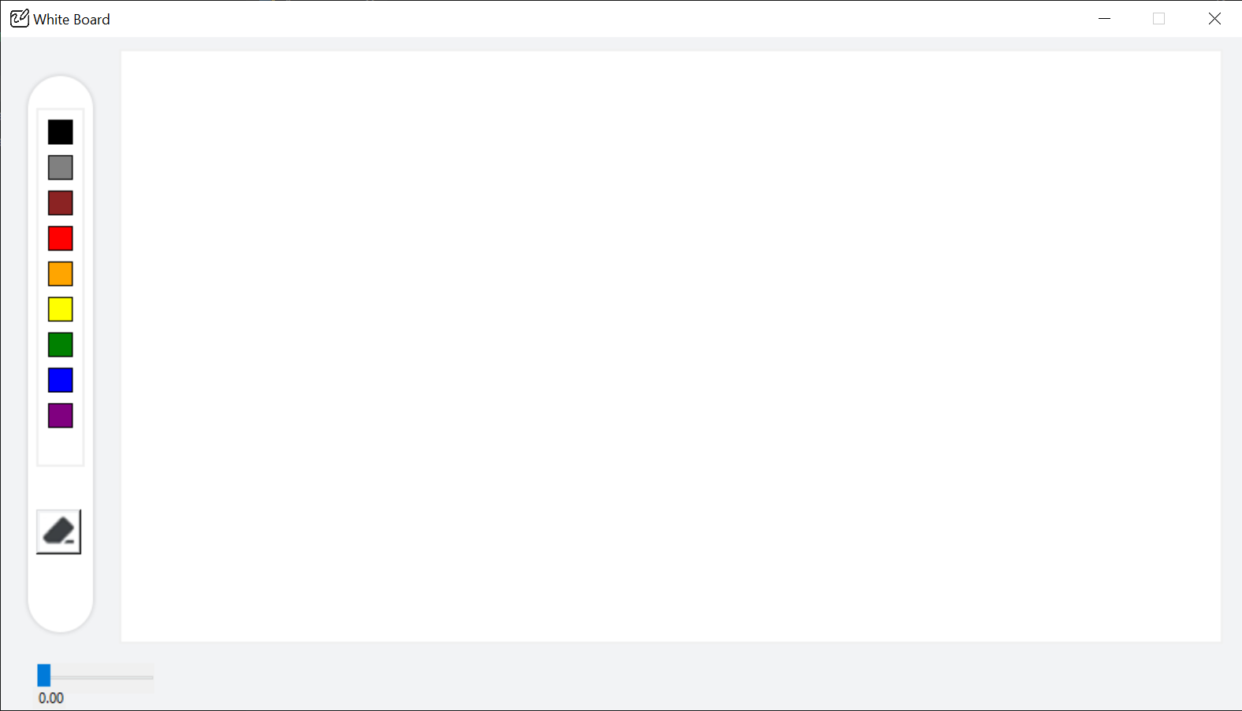
Dashboard Snippets

Slide 9
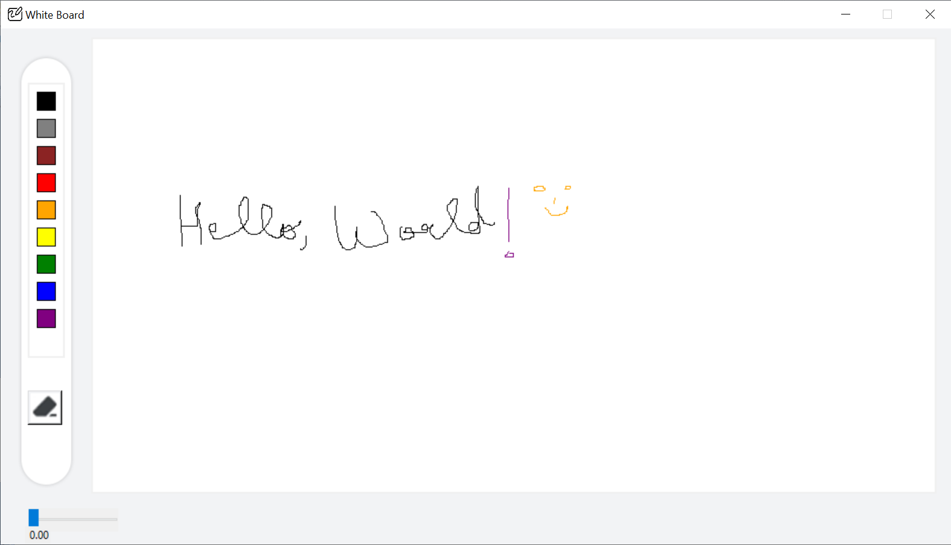
Dashboard Snippets

Slide 10
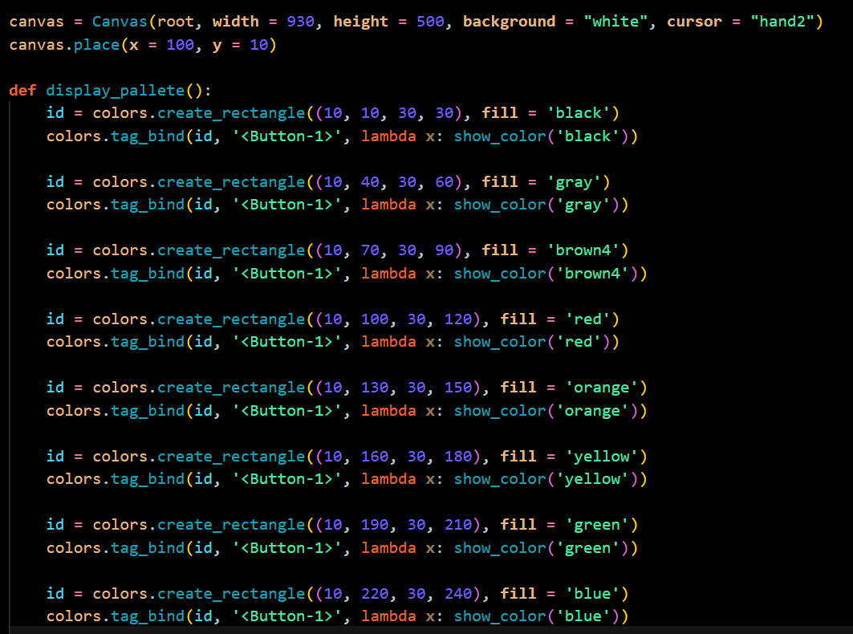
Code Snippets

Slide 11
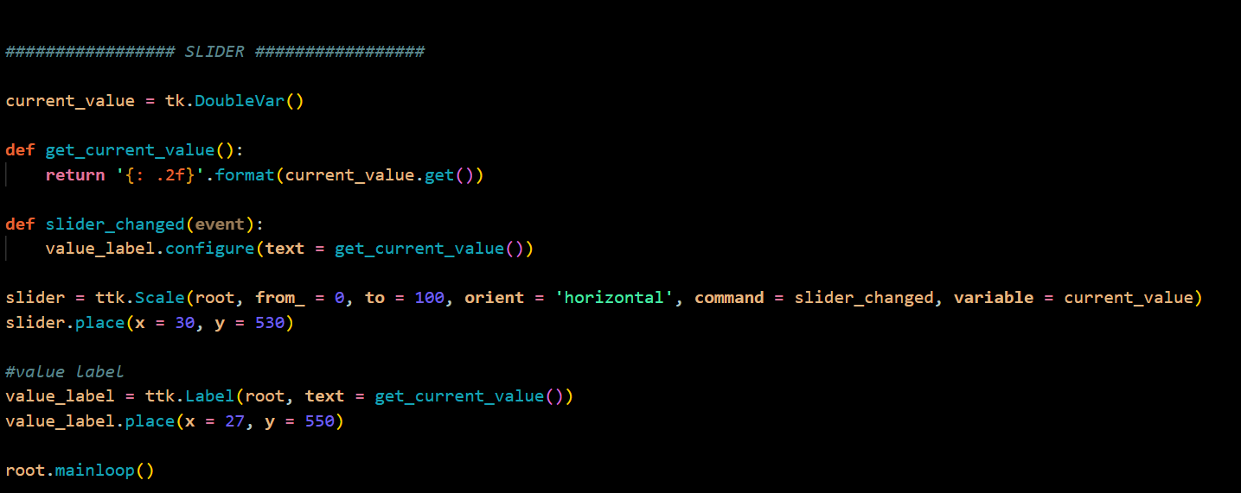
Code Snippets

Slide 12

References
Python Docs: https://docs.python.org/3/library/tkinter.html
YouTube: https://www.youtube.com
GeeksforGeeks: https://www.geeksforgeeks.org

Slide 13


